Slide 1
Fluency and Fitness
ABC

Slide 2
C

Slide 3
Z

Slide 4
p

Slide 5
a

Slide 6
I

Slide 7
m

Slide 8
N

Slide 9
f

Slide 10
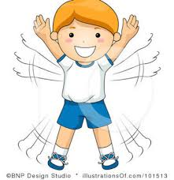

Slide 11
V

Slide 12
t

Slide 13
d

Slide 14
q

Slide 15
E

Slide 16
B

Slide 17
w

Slide 18
H

Slide 20
S

Slide 21
j

Slide 22
u

Slide 23
G

Slide 24
y

Slide 25
R

Slide 26
K

Slide 27
X

Slide 29
c

Slide 30
T

Slide 31
S

Slide 32
X

Slide 33
L

Slide 34
r

Slide 35
e

Slide 36
b

Slide 37
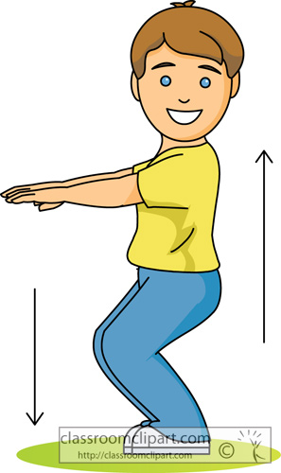

Slide 38
o

Slide 39
U

Slide 40
A

Slide 41
i

Slide 42
n

Slide 43
P

Slide 44
r

Slide 45
F

Slide 47
l

Slide 48
J

Slide 49
Y

Slide 50
v

Slide 51
z

Slide 52
x

Slide 53
k

Slide 54
W

Slide 55
D

Slide 56
O

Slide 57
g

Slide 58
